Slide 2


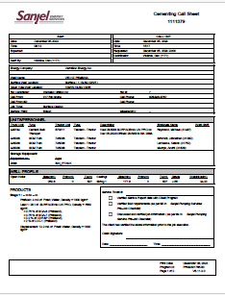
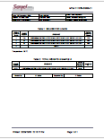
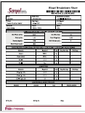



Logistics Workflow
On Location
On Location
GWC
Haul
Call Sheet
On Way In
Load
Requested
MTS
Scheduled
Blend Request
Stored
En Route
BlendCompleted
Blending
Load
Requested
Loading *
MTS
Returned
Loaded
Blend Train
Loaded
Program
Bulker Crew Status
Blend Status

